Slide 1
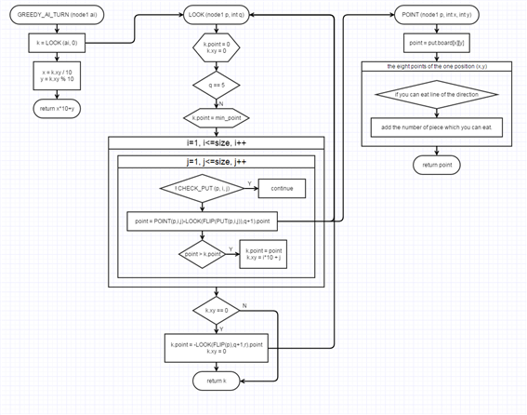
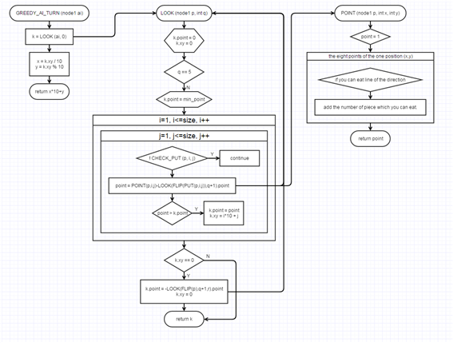
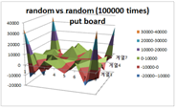
Strategic Analysis of Othello game and Produce the Learning Algorithm
♧ Researcher : Yu_Seop Lee, Sun_Jin Jeong (Jeonnam Science High School 2 grade)
♧ Guidance Teacher : Ji-Su Ryu (Jeonnam Science High School)
Ⅰ. Motive of Research
Through the analysis, we made algorithms which include strategic analysis.
☆ Greedy algorithm
: This is the algorithm which put where AI can eat the maximum number of pieces.
☆ Geographic algorithm
: This is the algorithm which put where AI can eat piece which has the highest points.
To check the ability of these algorithms which we made, we did a tournament between
several types of AI. ( can go step ahead three and five pieces, learned by human)
① Match between AI(3) VS AI(5) ② AI which was learned by human.
Recently there was a game between Lee Se-Dol and AlphaGo. AlphaGo is a artificial intelligence device developed in google and it is made of algorithm. Algorithm is essential to make a computer program. We are interested in algorithm, so we try to make a game program with making new algorithms. We decided to make a game program named “Othello” and head a strategic analysis. Besides we do make new algorithms to use in the program.
Research 3. Making Learning Algorithms
Ⅱ. Content of Research
▶ ▶
Research 1
Making Othello game
Research 2
Making new algorithms
Research 3
Check the ability of algorithms
Ⅲ. Theoretical Background
☺ Othello Game
A kind of board game
☺ Algorithm
: Gathering of several motions to sole the problem.
Fig 4. greedy algorithm
※ Rule
① At first, place four pieces on the middle of the board.
② You must put a piece which surrounding opponent’s piece to eat.
③ If you can’t overturn opponent’s piece, there will be over order.
④ In the end, a player who have more pieces will be a winner.
Fig 5. geographic algorithm
Research 4. Check the ability of Algorithms
Ⅳ. Process of Research and Result
Research 1-1 Making Othello program using C-language program.
We made a Othello game program.
To check the winning rate of othello board, we did a contest between random AI and random AI.
Research 1. Making Othello game Program
Fig 7. AI(3) VS AI(5)
Fig 8. a graph of the winner
Fig 1. Main screen of game
Fig 2. board.
Result | According of above graphs, we know that putting on the vertex point is the most advantageous in any case. And we know that putting on some of the edge is advantageous too. The graph which was win is similar the graph which we found in random graph.
Research 2. Strategic Analysis of Random AI
Ⅴ. Conclusion
① We could make 'Othello game' program by using C language program.
② We did a strategic analysis about the optimum way in board, and we
found out that putting a piece on the vertex in the board has the
highest percentage of victory.
③ We could make two algorithms which include strategic analysis,
is named 'Greedy algorithm and Geographic algorithm.
④ We got a graph which was progressed in matches and it is similar
the graph which we found in random graph.
⑤ We could educate AI with using algorithms. And we judge
that our algorithms are suitable to use in 'Othello game' program.
Fig 3. random vs random 100000 times
Result | Value number of Vertex has the most value among the Othello game board. This means that if you put a piece on the vertex, and then the piece which is located in vertex couldn't be eaten at all.

